Slide 1

Jmeter PerforMance Testing
By Gunasekhar

Slide 2
Agenda
Introduction to Performance Testing
Different Tools and a JMeter
Demo on Google Search in Browser
Demo on Google Search in JMeter
Results walkthrough

Slide 3
Introduction to Performance Testing
Why we need Performance testing
To test the speed, reliability, response time, and resource usage. The goal behind performance testing is to identify and eliminate any potential resistances to the software application
Load Testing
Load testing is a type in which it tests an application for its performance at normal and peak usage.
The performance is checked as per the response time and consistency on different user loads.
Volume Testing
Volume testing is a type where the system's performance is checked concerning the volume of data.
To perform the test, it enters a vast amount of data into the database.
Stress Testing
Stress testing is a type in which different ways to break the system are found, i.e., how much load a system can sustain.
It checks how much load a system can hold in an incremental approach.
Capacity Testing
Capacity testing is a type in which it checks an application for its capability to meet business volumes.
The testing is performed, keeping in mind the prospects of an application and the number of users.
Reliability Testing
Reliability testing is when the application is verified if the application would become normal again after an abnormal state.
It estimates the time that the system would take to return to its normal state.
Scalability Testing
Scalability testing is a type where the application is determined if it could scale up whenever needed.
The need for scaling up comes when there is an increase in user load.

Slide 4
Different Tools and a JMeter
Tools for Performance Testing
WebLoad
LoadUI
NeoLoad
JMeter
Why JMeter ?
Free of Cost
Performance Testing of Application
Load Testing and Stress Testing
Multiple Thread Groups to Run Simultaneously
Graphical and Tabular Representation of Results
Platform Independent as in JVM

Slide 5
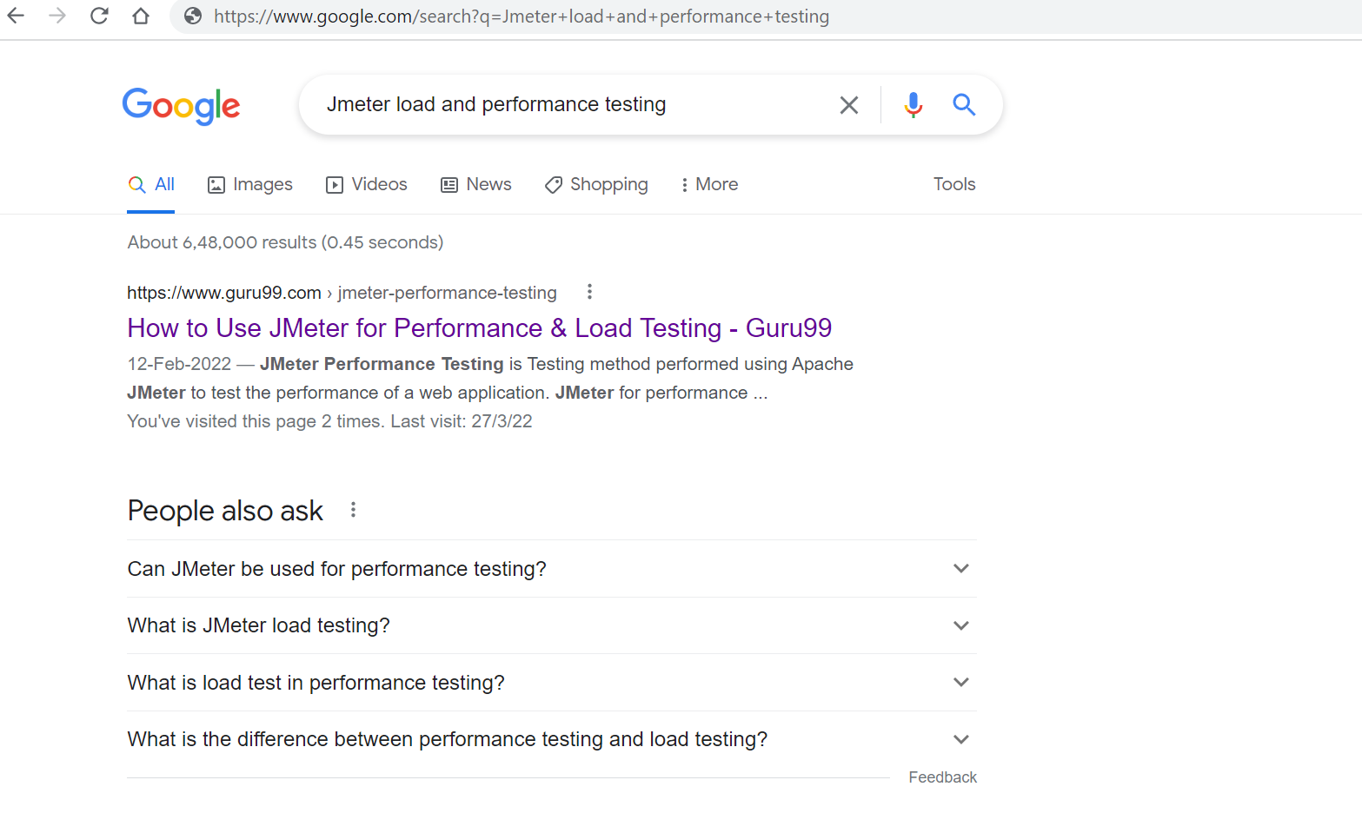
Demo on Google Search in Browser

Slide 6

Demo on Google Search in JMeter

Slide 7
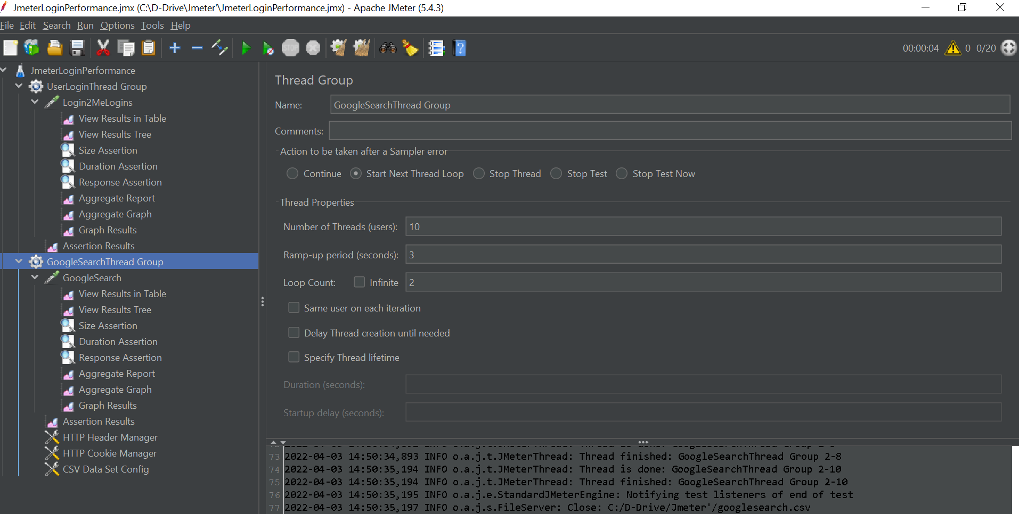
Thread Group is the number of users who will be used to create or run the test.

Slide 8
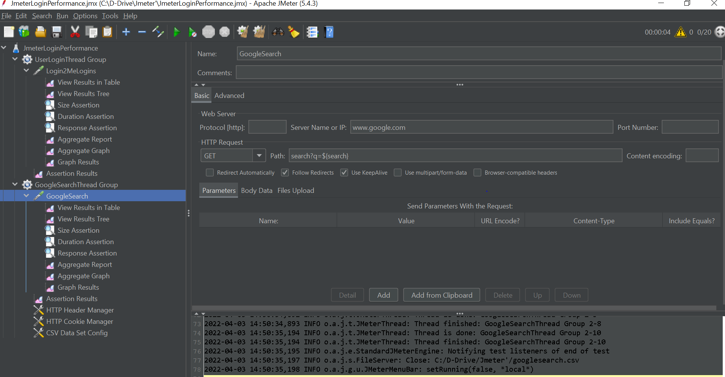
HTTP Request to do Google Search the test.
Dynamic String for every search in Thread Group will Assign to user

Slide 9
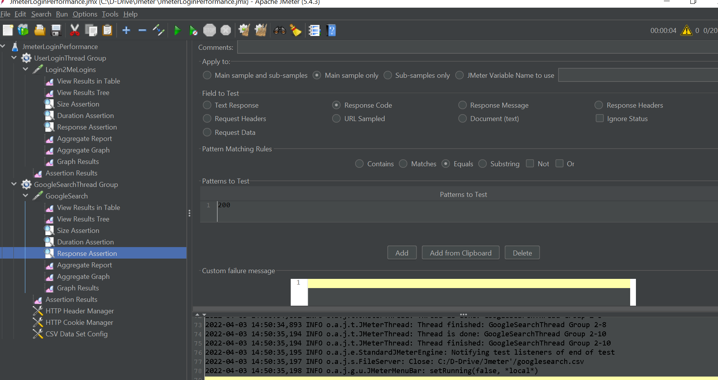
Validating Results against to 200 Response Code

Slide 10
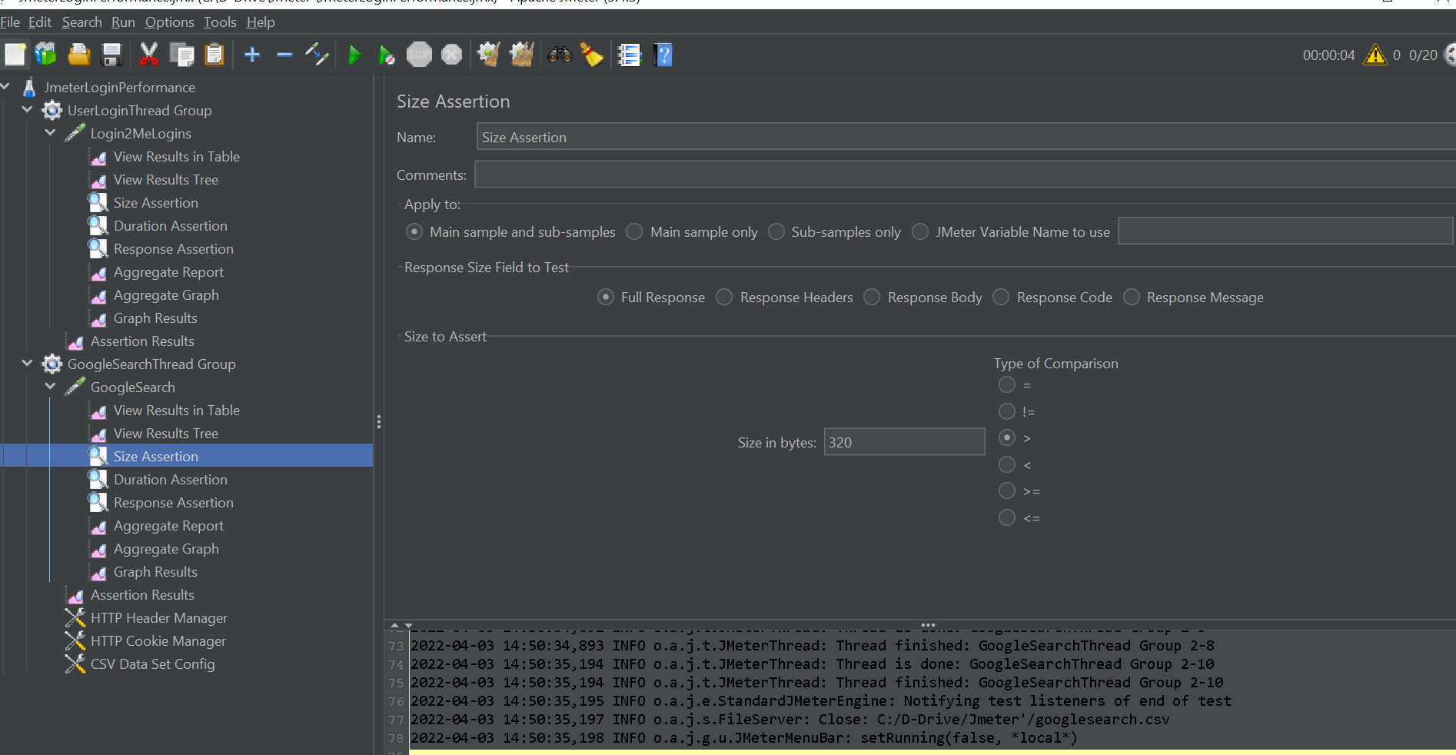
Comparing Response size validating to > 320 bytes to Pass

Slide 11
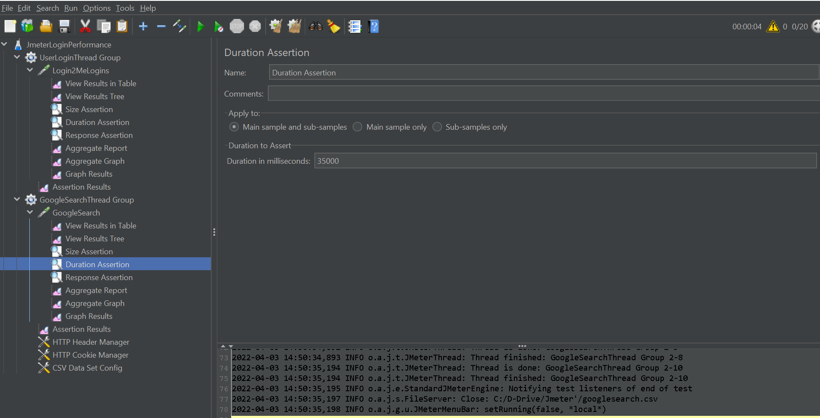
Response duration < 35000 milliseconds to Pass

Slide 12
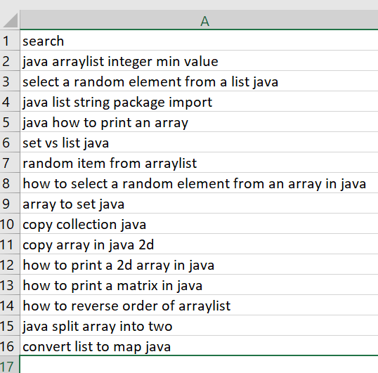
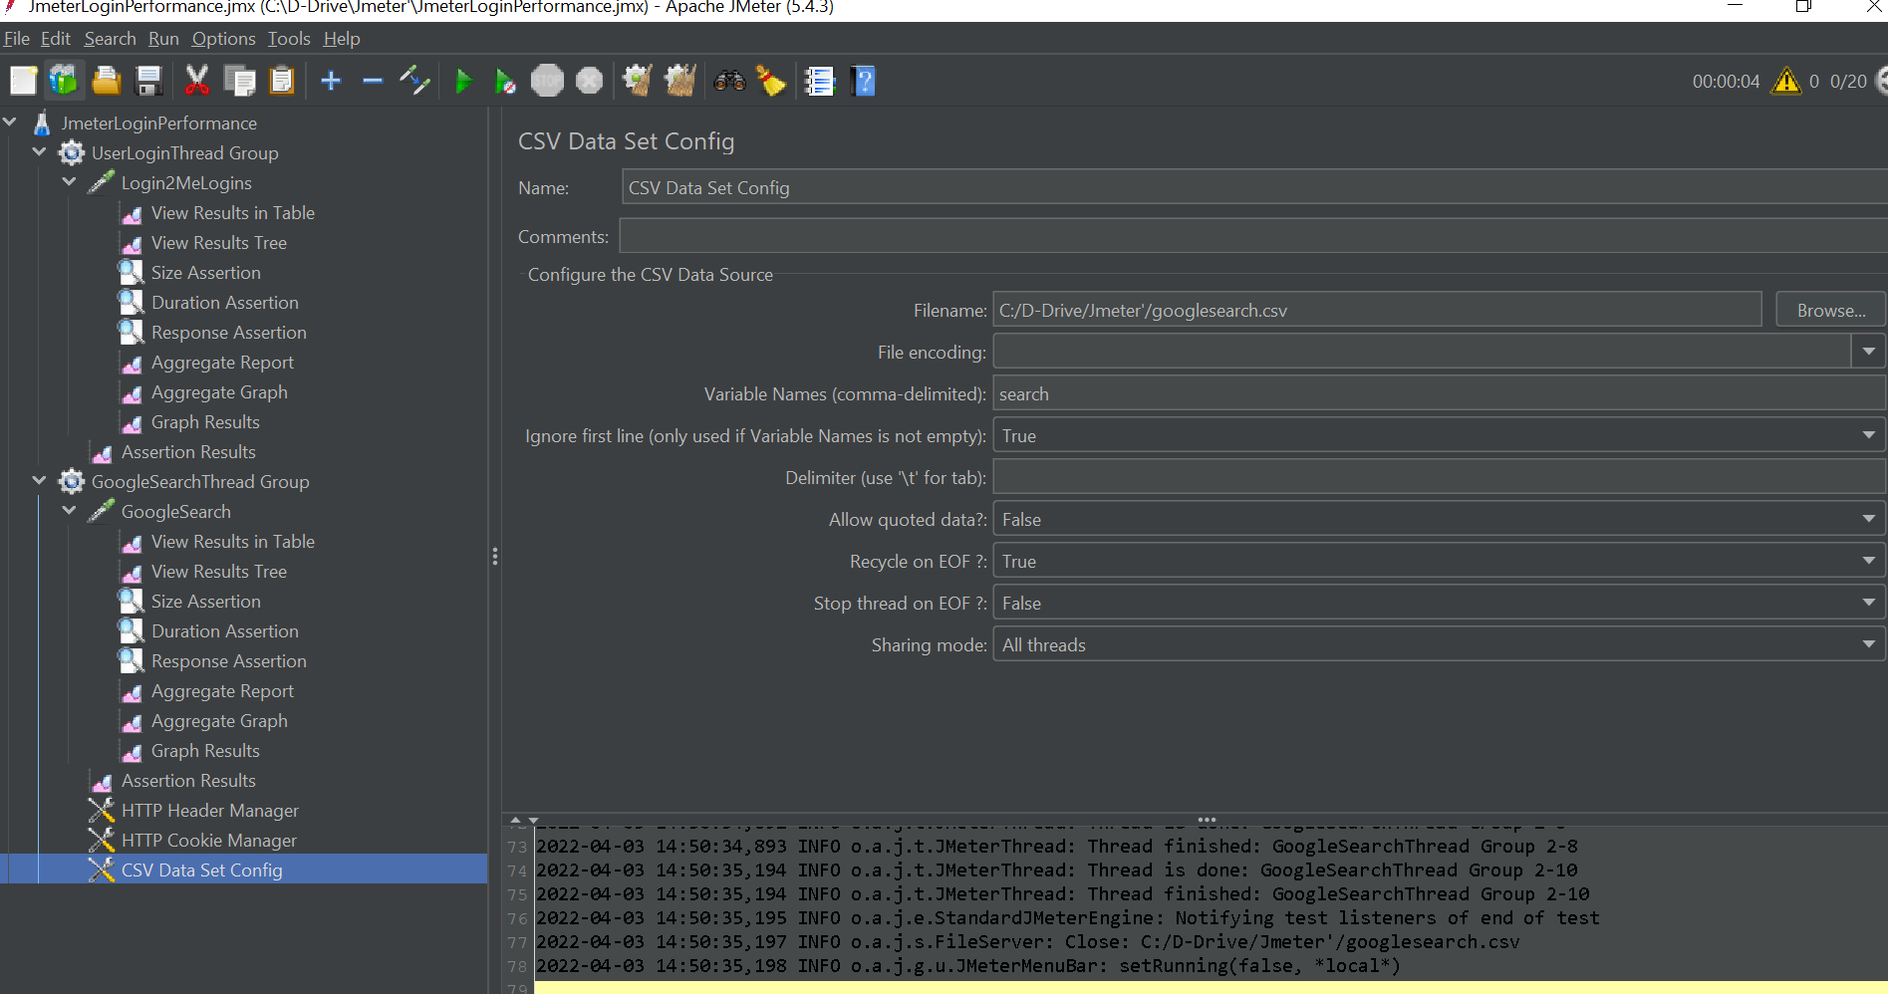
CSV File Sample
CSV file with list of search string to be added to query param

Slide 13
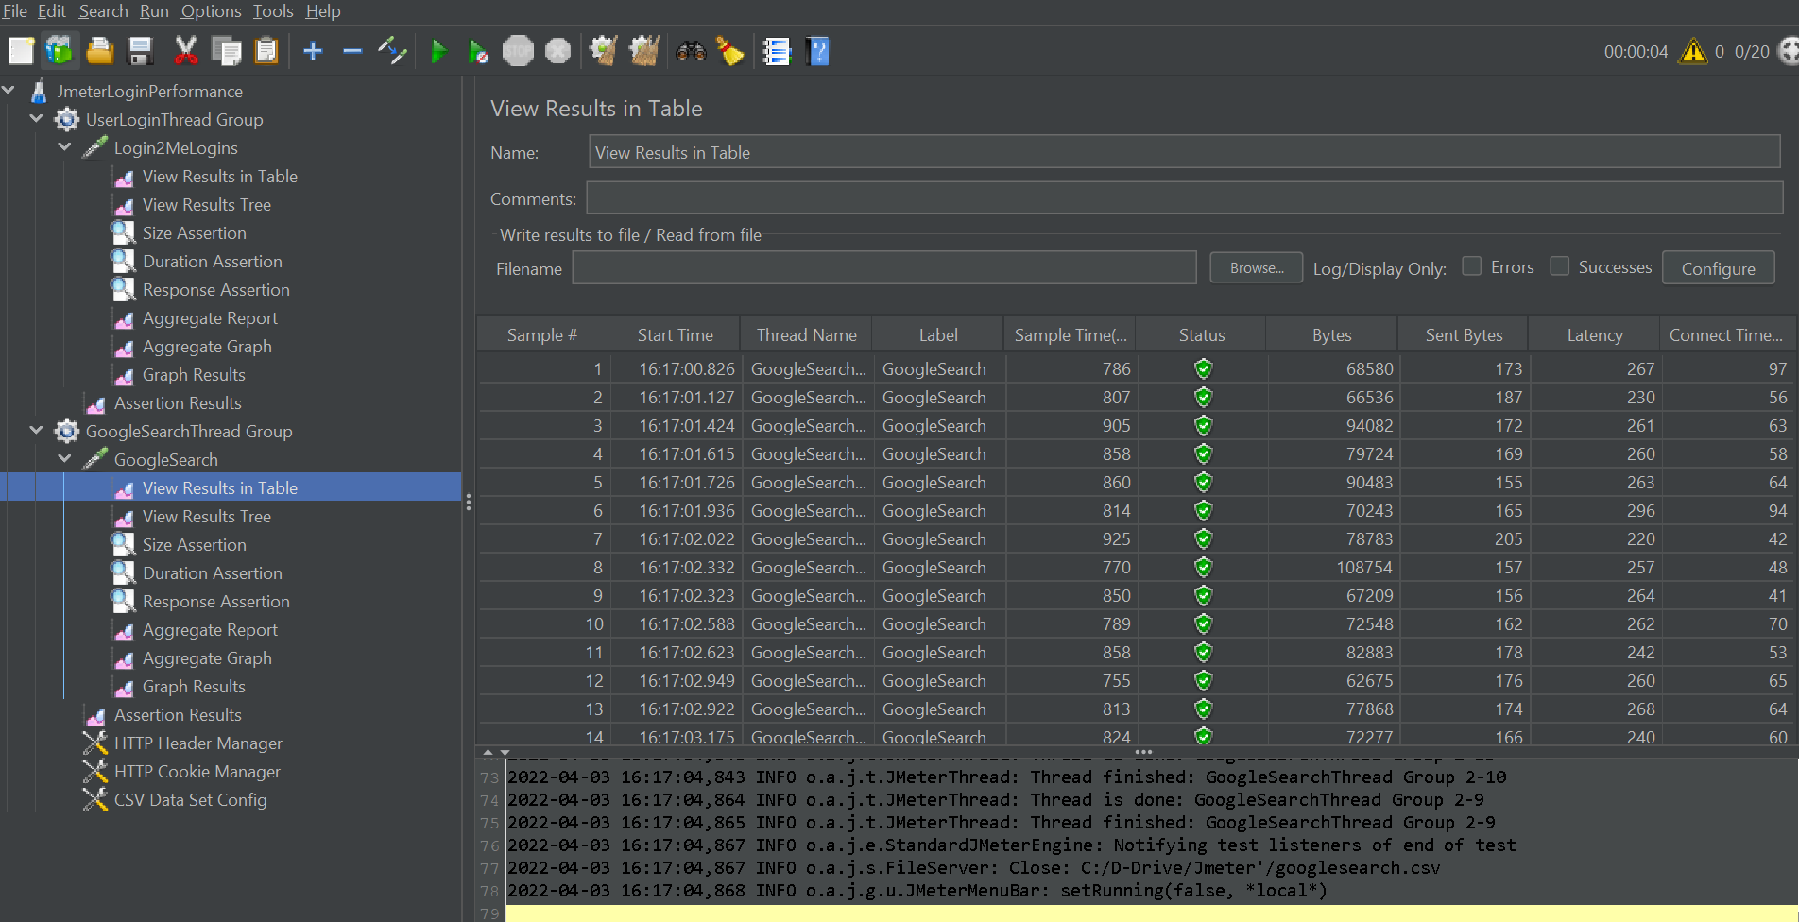
Individual Thread Execution and its Status

Slide 14
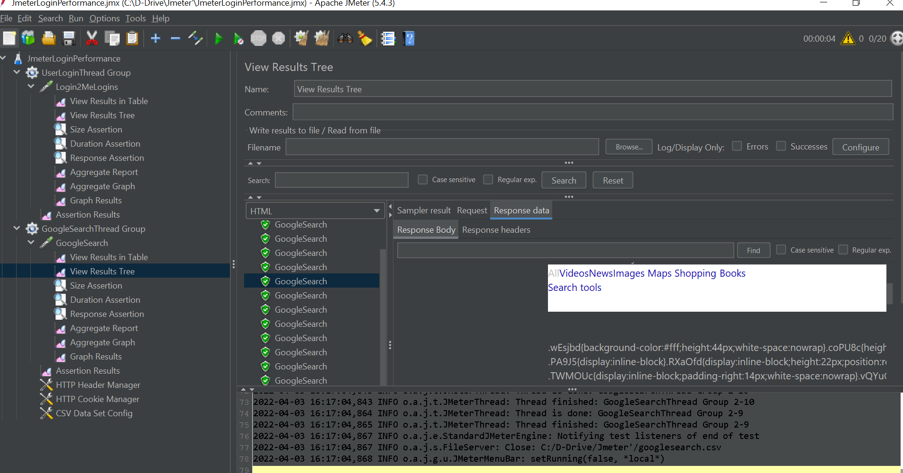
Request Sent, Response for Each execution BY Thread Group

Slide 15
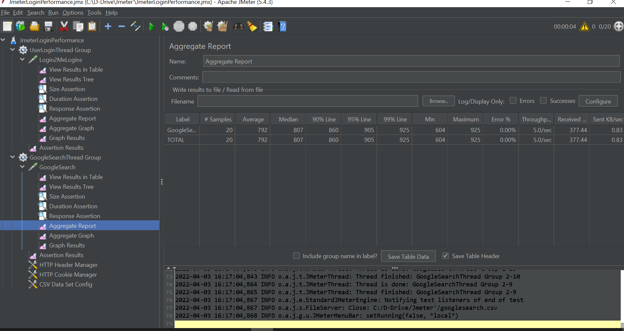
Aggregate of all threads, Error %, Response Time in milliseconds

Slide 16
Tools Required For Development
Tools for Performance Testing
JDK ( https://www.oracle.com/java/technologies/downloads/ )
JMeter (https://jmeter.apache.org/download_jmeter.cgi )
BlazeMeter (https://chrome.google.com/webstore/detail/blazemeter-the-continuous/mbopgmdnpcbohhpnfglgohlbhfongabi?hl=en )
Jenkins Integration (https://www.jenkins.io/doc/book/using/using-jmeter-with-jenkins/ )

Slide 17
Thank You
Demo By Gunasekhar

